Slide 1
Emotion Tracker App Project
Module: CSC7084: Web Development (2231_FYR)
Student Name: Ciaran Neeson
Student Number: 15615014
Walkthrough Video:
https://qubstudentcloud-my.sharepoint.com/:v:/g/personal/15615014_ads_qub_ac_uk/EdAQUchXBENCpxcTy4EiAtoBxTvBt5NJngY5uxl0stuFAw?e=qkgLr9
GitHub repository: https://github.com/ctneeson/emotiontracker2

Slide 2
Specification
A modern, responsive data-driven web app should be designed, developed and tested that provides the following functionality
Facilitate multiple users such that individual users should be able to register, login and logout. Data specific to an individual user should only be accessible to the corresponding user
Provide appropriate validation of any user input where necessary, along with appropriate user authentication and address potential security vulnerabilities
When logged in, a user should be able to record a snapshot of their current emotional state. The information recorded by the snapshot should include values for the user’s current levels of enjoyment, sadness, anger, contempt, disgust, fear, and surprise, along with the current date and time. The snapshot should also include an optional set of contextual triggers
When logged in, a user should be able to view a list of all previously recorded snapshots
The user should be able to select an individual snapshot from the list and change (e.g., add or modify) contextual triggers associated with recorded levels of emotion, or delete the snapshot
When logged in, a user should be able to view a summary visualisation of previously recorded emotional states over time, along with related, relevant statistics or information

Slide 3
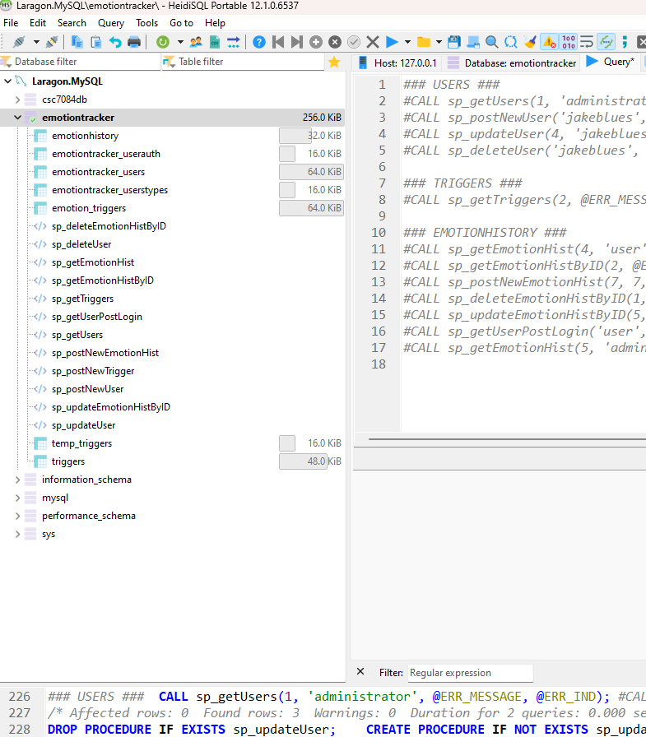
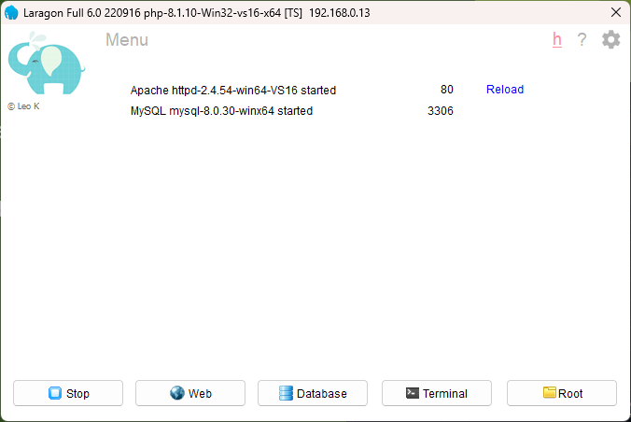
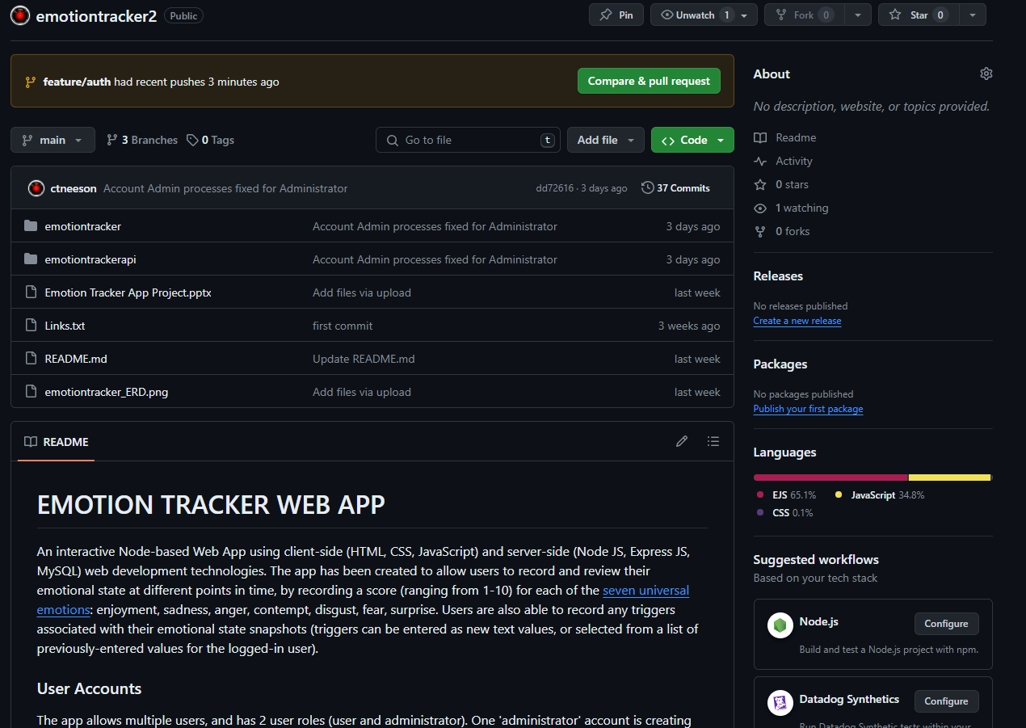
Project Requirements
Software requirements
Development environment: Laragon
VS Code
Postman
Browser (Opera in this demonstration)
Setup instructions
SQL scripts to create tables & populate sample data
Test accounts (admin:admin123 & user:user123)
Constraints incl. FKS
Password encryption
Stored procedures
11 SPs to be created – see slide 8 for individual details
GitHub repository: https://github.com/ctneeson/emotiontracker2

Slide 4
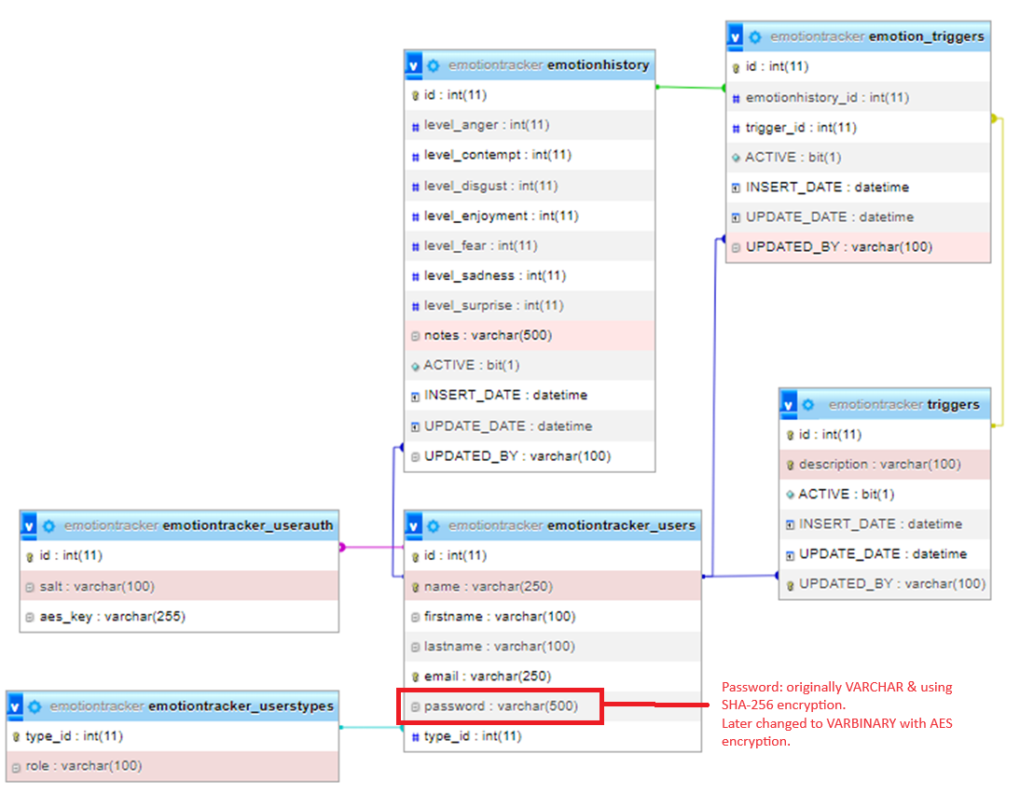
Database Design
Considerations
XAMPP: many shortcomings (Laragon used instead)
Triggers considered on insert/delete but avoided due to complexity
Reliance on UPDATED_BY column to match user name in joins (sometimes admin can update on behalf of another user)
Selecting MAX(id) from emotionhistory when inserting new snapshot in order to link to other tables - using a Run ID would be more advisable
Considered soft deletions (ACTIVE column on certain tables) but this added complexity to queries
Password datatype

Slide 5
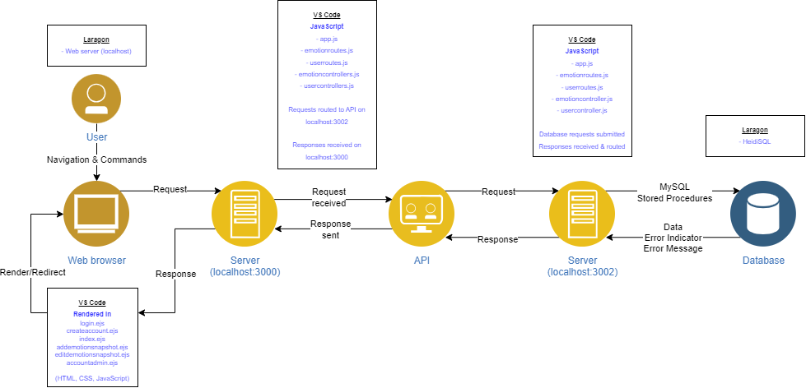
System Implementation

Slide 6
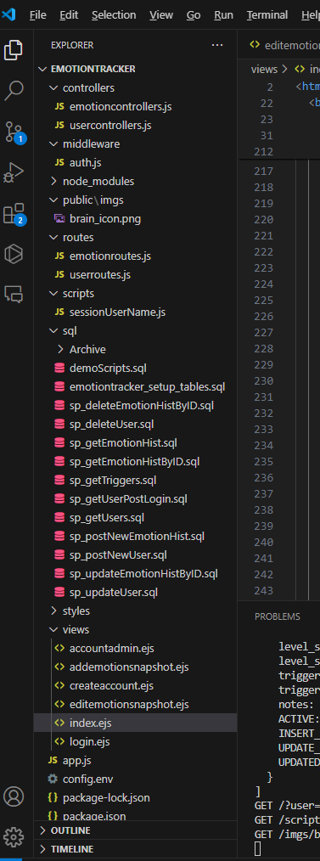
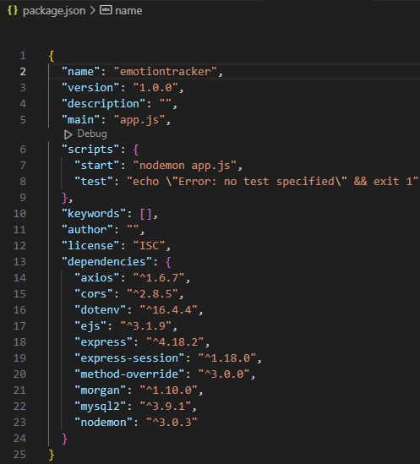
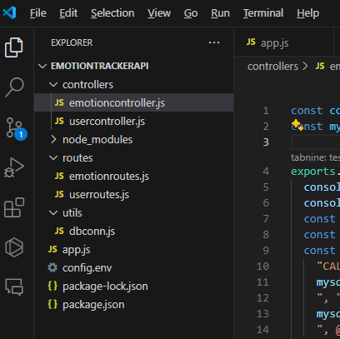
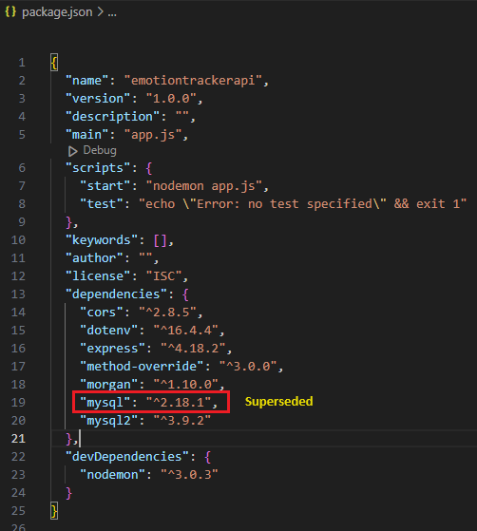
Project Structure
Client-side
Server-side

Slide 7







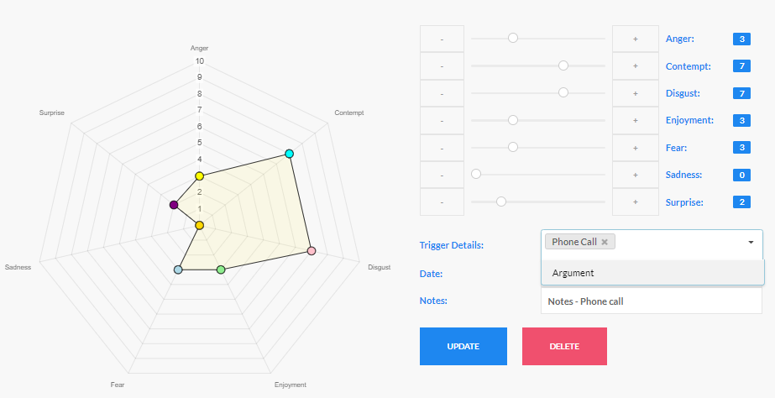



Development Approach
Developing while learning & a lot of rework required as new considerations
Slow pace in early days, often getting stuck & unable to find help / unaware of resources
Discovery of most important resources - some happened by accident
GitHub sync added when a basic working prototype was achieved
Heavy leveraging of SQL for server-side manipulation & validations to speed up progress
Time constraints vs. code modularity
JavaScript libraries: UIKit, Semantic UI (dropdown), Chart JS (radar charts), jQuery (API requests - $.post & $.ajax)

Slide 8
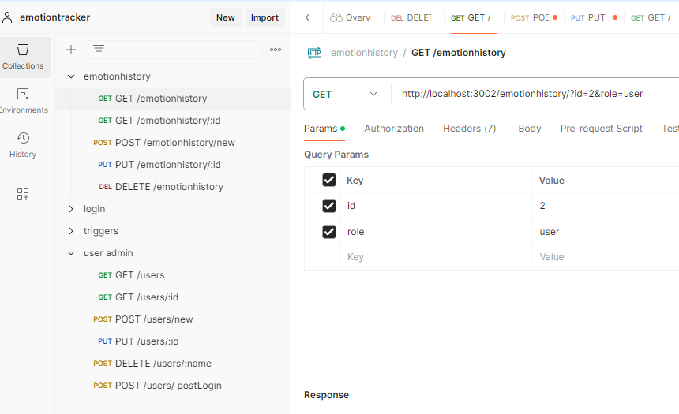
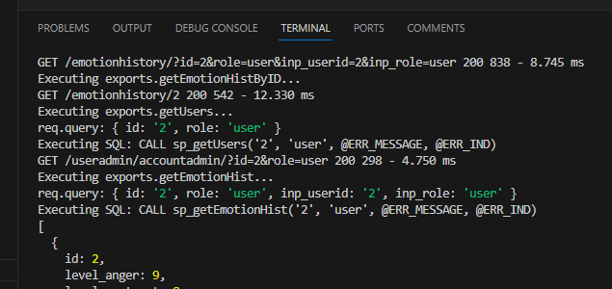
MySQL/API Walkthrough
Database Setup
HeidiSQL via Laragon
emotiontracker_setup_tables.sql
Stored Procedures
sp_postNewUser: Create new account (PW encryption)
sp_getUserPostLogin: Login validation
sp_postNewEmotionHist: Create snapshot
sp_getTriggers: used in Create/Edit snapshot
sp_getEmotionHist: snapshots overview
sp_getEmotionHistByID: Edit snapshot – view
sp_updateEmotionHistByID: Edit snapshot - update
sp_deleteEmotionHistByID: Delete snapshot
sp_getUsers: Account Admin
sp_updateUser: Update user details
sp_deleteUser: Delete user account & associated records

Slide 9
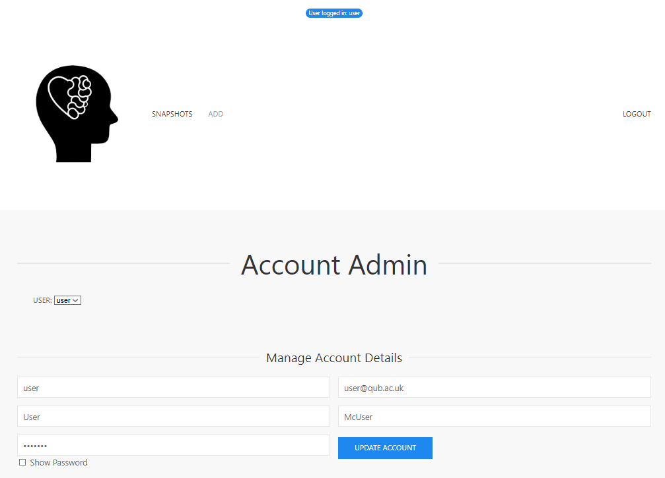
User Interface Walkthrough
Test User
Login & view snapshots
New User
Create account (data validations)
Login
Add snapshot (date validation)
Snapshots overview
Edit snapshot (triggers dropdown)
Delete snapshot
Account Admin
Admin User
Login & view different users’ snapshots
Edit/Delete snapshot of other user
Account Admin for other user (incl. assign new role / delete account)

Slide 10
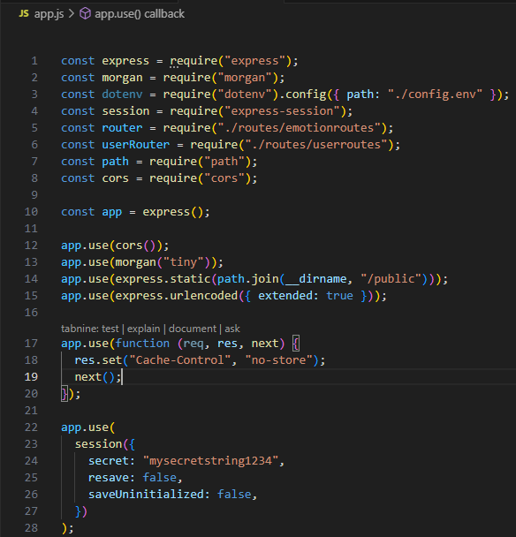
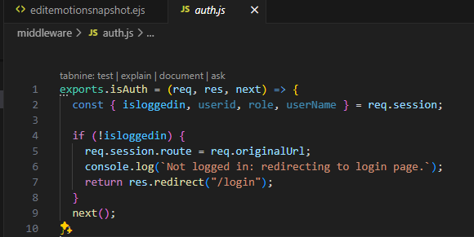
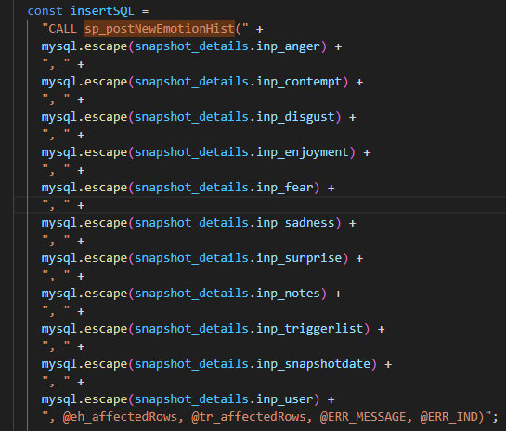
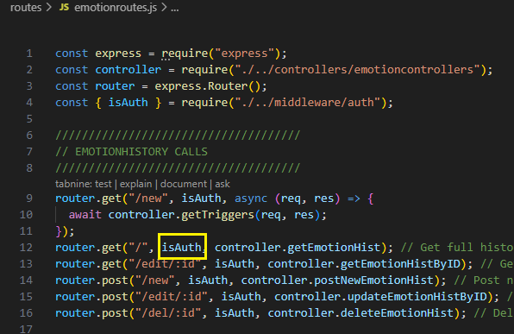
Security
Password Encryption
AES has been used for demo purposes but SHA-256 is preferred (although neither are 100% secure). Account Admin process would require revision to properly handle SHA-256
Session validation
Use of isAuth (auth.js) middleware & setting sessionUserName limiting user’s access to only what is permitted
Validations
Greater focus on server-side (due to the possibility of disabling JavaScript in browser)
Duplication of some checks on client-side
Disable buttons by default on client-side unless valid inputs are provided
Caching
Cache-Control in app.js on client side
SQL injection
mysql.escape(input) on server side

Slide 11
Improvements
Database Design
Soft deletes
Run IDs/row locking during account creation
Naming conventions
Encryption: storage of salt & key values (adopt an industry-standard policy)
Table indexing for query optimisation
Code modularity
Limited externalisation of inline scripts in EJS files (due to time constraints)
Potential inclusion of redundant elements
Helmet (or similar) permissions for authorised code libraries
User Experience
Password confirmation (enter twice to avoid typos)
Reset password option (would probably require link with email server and/or SMS for confirmation)
Verify account creation via email confirmation
MFA etc…
Deployment/Scalability
Negligible user numbers/data volumes in demo, so no idea about scalability
Little time to look at deployment options

